Slide 1
EECE 5117C/6017C Lab 1: Traffic Light Problem: Requirements Introduction to Altera tools and Circuit Simulation HW Exercises

Slide 2
Traffic Light Problem:
Your eventual goal is to design a finite state machine (fsm) to control the traffic lights at the intersection of Martin Luther King Drive and “Woodside Drive”.
Your team needs to:
--determine the state of the traffic light
--determine the relative length of each state
--add any additional states that are not obvious (e.g., “light is broken”) or that might help it be “smarter”
--define the resulting fsm:
states
state transitions
light pattern output for each state
any inputs
This description is due IN LAB Monday Sept. 11. Once your description is approved, you can implement the defined fsm, inputs, and outputs.

Slide 3
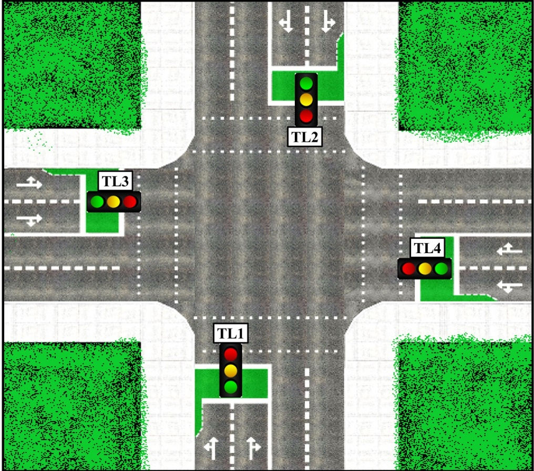
EECE 5117C/6017C Problem—Is This Accurate? Traffic Light Controller using FSM
Implement and Demonstrate the finite state machine for the traffic light using the LEDs, pushbuttons, and 7-segment displays in the DE0-10 lite; be sure that you verify that the description below is an ACCURATE description of the actual board
Traffic light problem in MLK and Woodside Dr Intersection
MLK is an EW road, 2 lanes in each direction.
For traffic going from E to W, there is a left turn lane.
There are also pedestrian crossings:
Cross MLK on east side of the Library street (P1)
Cross the Library street on N side of MLK (P2)
Traffic Light is green for MLK traffic twice as long as for library traffic.
Left turn lane has a signal that lasts 0.25 of time MLK light is green.
While left turn signal is green, MLK pedestrian signal is red.
Unspecified here: length of yellow signals in any direction.
The Picture shown here is a sample depiction – come up with your own, while designing
Map the LED s on the board to the traffic lights (Green, Amber and Red), Left Turn, and Pedestrian signals (P1 and P2)
Include in your design any additional information from class discussions.
MLK
P1
P2
Woodside Dr

Slide 4
Introduction to Altera tools and Circuit Simulation—individual, but work with your team Once you have installed your software, go to https://www.altera.com/support/training/curricula.html Choose Fundamentals Part 1; online; English Skim “read me first!” Work through: How to begin a simple FPGA design Verilog HDL basics Using the Quartus Prime Software—an Introduction You can also look at the examples on the slides below and use this material to master implementing and testing some simple Verilog designs Remember to include COMMENTS, including your name, the date, and what each module does Verilog HW: next slide—due in lab (code + demo—team): Monday Sept. 11

Slide 5
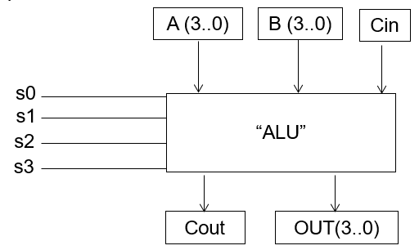
HW: ALU Design--I
2. Design a BEHAVIORAL implementation for ALU as explained below.
The ALU has three inputs: two 4-bit signed values and a 4-bit control signal that determines which operation the ALU should perform. The ALU has a single 4-bit signed output (plus a carry-out for the adder) which is the result of the operation. The ALU can perform ten operations as per the table below.
The ALU should instantiate a single 4-bit adder (also used for subtract), and a left/right shifter. Use the outputs from these modules and some combinational logic to generate all ten possible values. Finally, use a multiplexer to select the correct signal.
Simulate the ALU output in Quartus and show the final result using the LEDs in the DE10-Lite board.
Description | Instruction | Control S[3:0]
Addition | ADD | 0100
Subtraction | SUB | 0101
Bitwise NOT | NOT | 1000
Bitwise OR | OR | 1001
Bitwise AND | AND | 1010
Bitwise XOR | XOR | 1011
Shift LEFT | SLL | 1100
Shift RIGHT | SRL | 1101
Shift Right Arithmetic* | SRA | 1110
Pass A Through | CPY | 1111

Slide 6
ALU Design—II: Points to remember while implementing:
If any control signal other those specified is given to the ALU, the ALU should set all 8 output bits to zero.
The NOT operation returns the logical inverse of the first ALU input, and it ignores the second input
The SUB operation computes output = A - B.
For the shift operations, A is the value to be shifted and the four lower bits of B determine the amount of the shift (0 to 4 binary digits).
The arithmetic shift right* performs sign extension; in contrast, the logical shift right performs zero extension.

Slide 7
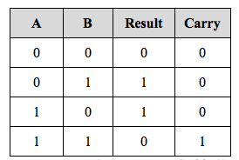
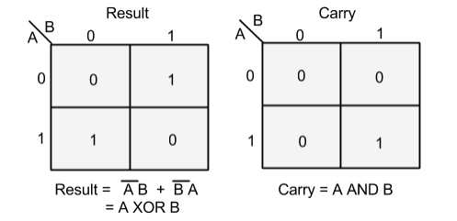
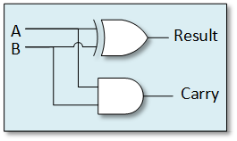
Additional Verilog examples: 1. Half Adder
A half adder is a circuit that receives two 1-bit inputs and adds them together to generate a 1-bit result (sum) and a 1-bit carry. The basic building blocks (gates) of a half adder consist of an XOR gate and an AND gate.
Start the design process by creating a truth table, showing all possible input combinations and writing down the expected output states.
Verilog Code—note comments, indentation:
//module for halfadder
//input bits a,b; output bits sum, carry
//designed by YOURNAME on THISDATE
module halfadder(a,b,sum,carry);
input a,b;
output sum, carry;
assign sum = a^b; // sum bit
assign carry = (a&b) ; //carry bit
endmodule

Slide 8
Test Bench (half adder)
//testbench for halfadder
//input bits a,b; output bits sum, carry
//designed by YOURNAME on THISDATE
`timescale 1 ps/ 1 ps
module halfadder_vlg_vec_tst();
// general purpose registers
reg a;
reg b;
// wires
wire carry;
wire sum;
// assign statements (if any)
halfadder testunit ( // port map - connection between master ports and signals/registers
.a(a),
.b(b),
.carry(carry),
.sum(sum)
);
initial
begin
#400 $stop;
end
// a
always
begin
a = 1'b0;
a = #200 1'b1;
#200;
end
// b
always
begin
b = 1'b0;
b = #100 1'b1;
#100;
end
endmodule

Slide 9
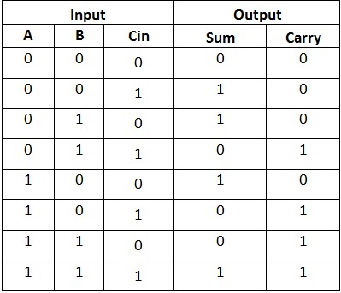
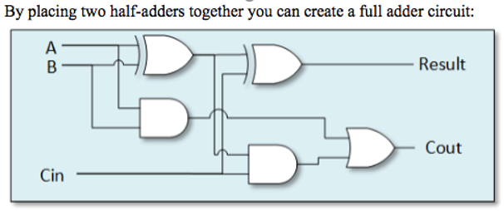
2. Full Adder
Using the half adder example, Write the Verilog code for a Full Adder, that takes in three 1-bit inputs, a, b and carryin, and gives sum and carryout 1-bit outputs. Write the code for a test bench for the adder, and give appropriate inputs to test all possible combinations.
Verilog Code:
//module for fulladder
//input bits a,b,cin; output bits sum, carry
//designed by YOURNAME on THISDATE
module fulladder(a,b,cin,sum,carry);
input a,b,cin;
output sum, carry;
-→ Enter Code here
endmodule

Slide 10
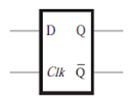
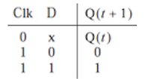
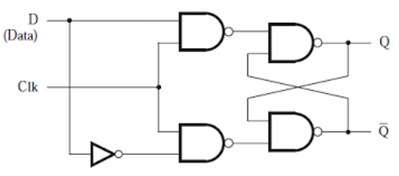
3. D Flip Flop (Delay)
The D type flip-flop has one data input 'D' and a clock input. The circuit edge triggers on the clock input. The flip-flop also has two outputs Q and Q' (where Q' is the reverse of Q).
The operation of the D type flip-flop is as follows: Any input appearing (present state at t) at the input D, will be produced at the output Q in time t+1 (next state). e.g. if in the present state, we have D = 0 and Q = 1, the next state will be D = ‘x’ and Q = 0 (previous state).
The positive edge triggered D flip-flop can be modeled using behavioral modeling as shown below.
Verilog Code:
//module for D flipflop
//input bits D,CLK (clock); output bits Q,Qi (Q-inverse)
//designed by YOURNAME on THISDATE
module dflipflop(D, Clk, Q, Qi);
output Q,Qi;
input D, Clk;
reg Q,Qi;
initial
begin
Q=1'b0;
Qi=1'b1;
end
always @ (posedge Clk)
begin
Q=D;
Qi=~D;
end
endmodule

Slide 11
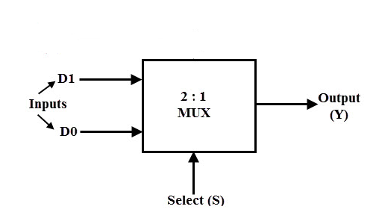
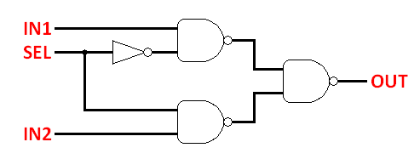

4. 2 to 1 MUX
A 2-to-1 multiplexer has two inputs D0 and D1, one select input S and one output Y. Since there are two input signals only two ways are possible to connect the inputs to the outputs, so one select is needed to do these operations.
Depending on the selector switching the inputs are produced at outputs , i.e., D0 , D1 and are switched to the output for S=0 and S=1 respectively .
With the truth table for 2 to 1 multiplexer and write a test bench for the given mux Verilog module. Corresponding expression for mux output Y is given below
The Verilog code can also be written using “case” statements or by simply using conditional operator (?: ) with assign statement.
Verilog Code:
//module for 2-to-1 mux
//input bits D0,D1,S(select); output bit Y
//designed by YOURNAME on THISDATE
module mux2to1( D0 , D1 , S, Y);
input D0, D1, S;
output Y;
reg Y;
always @ (S or D0 or D1)
begin
if (S == 1'b0)
begin
Y = D0;
end
else
begin
Y = D1;
end
end
endmodule
SELECT (S) | IN1 (D0) | IN2 (D1) | OUT (Y)
0 | 0 | X | 0 (D0)
0 | 1 | X | 1 (D0)
1 | X | 1 | 1 (D1)
1 | X | 0 | 0 (D1)

Slide 12
Example: an altera state machine design:
what does the state diagram look like? Draw the transition diagram
Verilog Code:
//module for state machine
//input bits clk (clock), in, reset;
//output 4-bit value out
//designed by YOURNAME on THISDATE
module statem(clk, in, reset, out);
input clk, in, reset;
output [3:0] out;
reg [3:0] out;
reg [1:0] state;
parameter zero=0, one=1, two=2, three=3;
always @(state) begin case (state)
zero: out = 4'b0000;
one: out = 4'b0001;
two: out = 4'b0010;
three: out = 4'b0100;
default: out = 4'b0000;
endcase
end
always @(posedge clk or posedge reset)
begin
if (reset) state = zero;
else case (state)
zero: state = one;
one: if (in) state = zero;
else state = two;
two: state = three;
three: state = zero;
endcase
end
endmodule

